Slide 1
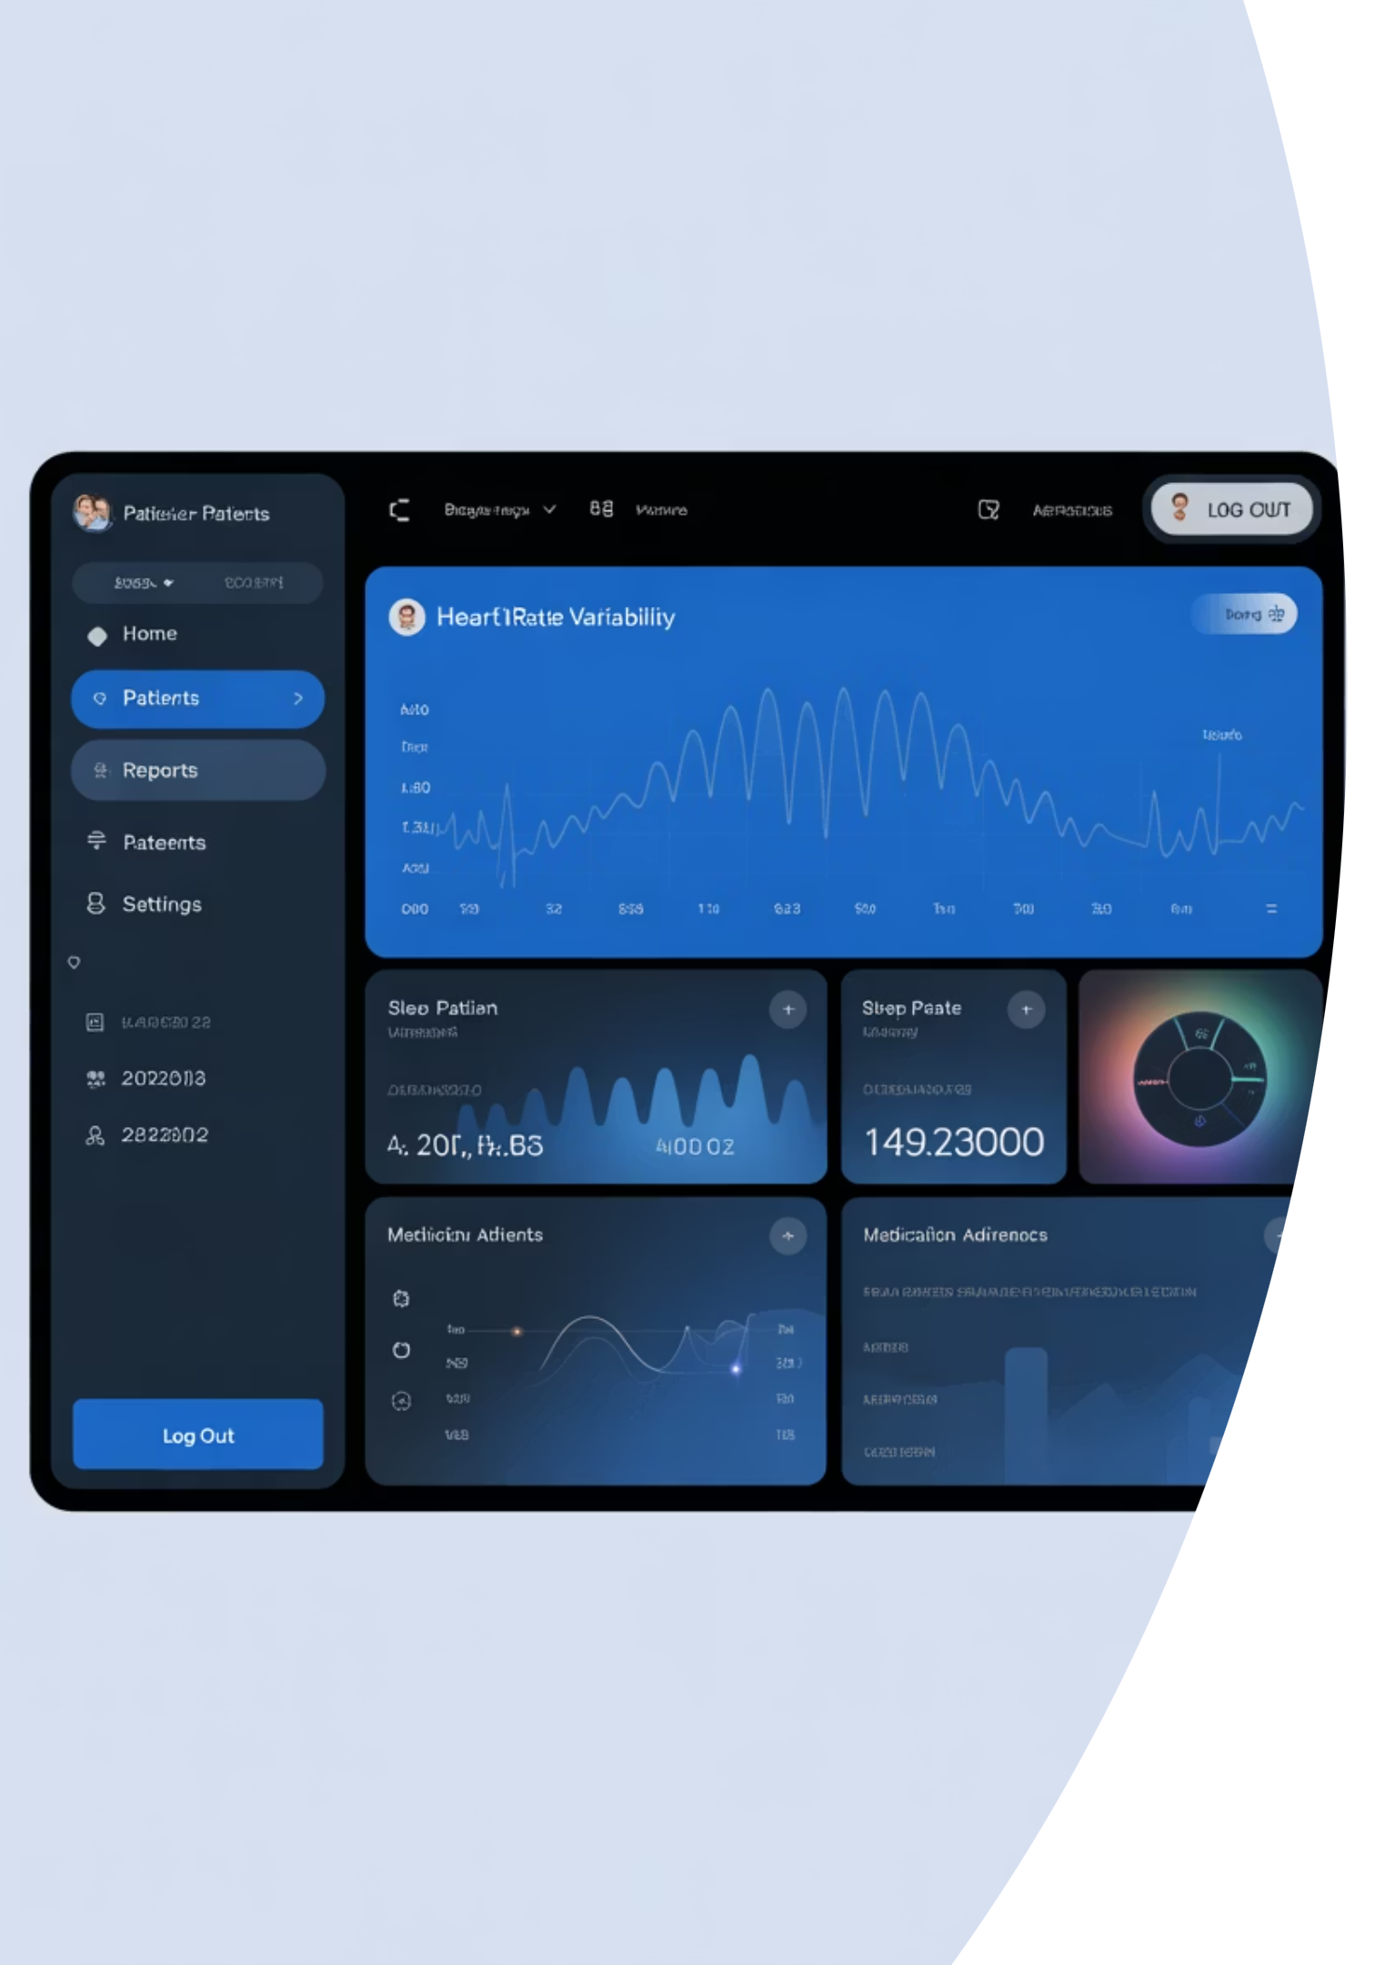
Project MedNexus: An AI-Powered Medical Information Hub
Leveraging Generative AI for Safe and Accessible Health Information

Slide 2
Project MedNexus
Title: Project Med Nexus: An AI-Powered Medical Information Hub
Subtitle: Leveraging Generative AI for Safe and Accessible Health Information
Presenter(s): Subhojit Roy 25030242060, Teja Abhinav Reddy 25030242061, V Adithya 25030242063
Date: September 21, 2025

Slide 3

The Problem
The Challenge of Online Health Inquiries
Patients often turn to the internet for initial medical advice.
Information can be unreliable, inaccurate, or cause unnecessary anxiety ("cyberchondria").
It's difficult for users to connect their specific symptoms to potential conditions in a structured way.

Slide 4
Our Solution: Project MedNexus
A Cautious, Conversational, and Credible First Step
Core Concept: Project Gamma is a Streamlit web application that acts as a sophisticated and safe front-end for Google's Gemini AI.
AI Symptom Checker
Generative Medical Q&A
Understands natural language descriptions of symptoms to suggest potential conditions from a curated dataset.
Answers general medical questions using AI grounded with web search results for up-to-date information.

Slide 5





Technology Stack
The Modern Tools Powering Medical Chatbot
Frontend: Streamlit
(for rapid, interactive web app development).
Backend & Data Processing
Python with Pandas (for managing the disease_symptoms.csv dataset).
AI Engine
Google's Gemini API (specifically, gemini-1.5-flash-preview-0514).
Key Python Libraries
requests (for API communication), json (for data handling).

Slide 6




Feature 1 - The AI Symptom Checker Workflow
From Natural Language to Actionable Insight
Flowchart Diagram:
User Input
AI Extraction (Step 1)
User describes symptoms in a text box (e.g., "I have a high fever, my head hurts...").
A Gemini API call with a specific prompt analyzes the text and extracts a structured JSON list of recognized symptoms (e.g., ['fever', 'headache', 'cough']).
Data Matching
AI Summary (Step 2)
A Python function (find_disease) scores potential diseases from the local CSV based on the extracted symptoms.
A second Gemini API call generates a user-friendly, conversational summary of the findings.
Follow-up: The user can then ask detailed questions about the potential condition.

Slide 7
The Core Innovation: Multi-Step Prompt Engineering
Ensuring Safety and Accuracy Through Layered AI Prompts
01
02
03
Prompt 1: Symptom Extraction
Prompt 2: Summary Generation
Prompt 3: Follow-up Q&A
Role: Expert Medical Symptom Recognizer.
Role: Friendly Medical Information Assistant.
Role: Cautious Medical Information Assistant.
Instruction: Must only return symptoms from a predefined valid list.
Instruction: Explain results conversationally and MUST end with a strong, clear disclaimer to consult a doctor.
Key Guardrails:
DO NOT write a disclaimer (the app hardcodes it).
Output Format: Strict JSON object ({"symptoms": [...]}).
Suggest general categories of treatments (e.g., "pain relievers"), NEVER brand names or dosages.
Always promote safety and professional consultation.

Slide 8
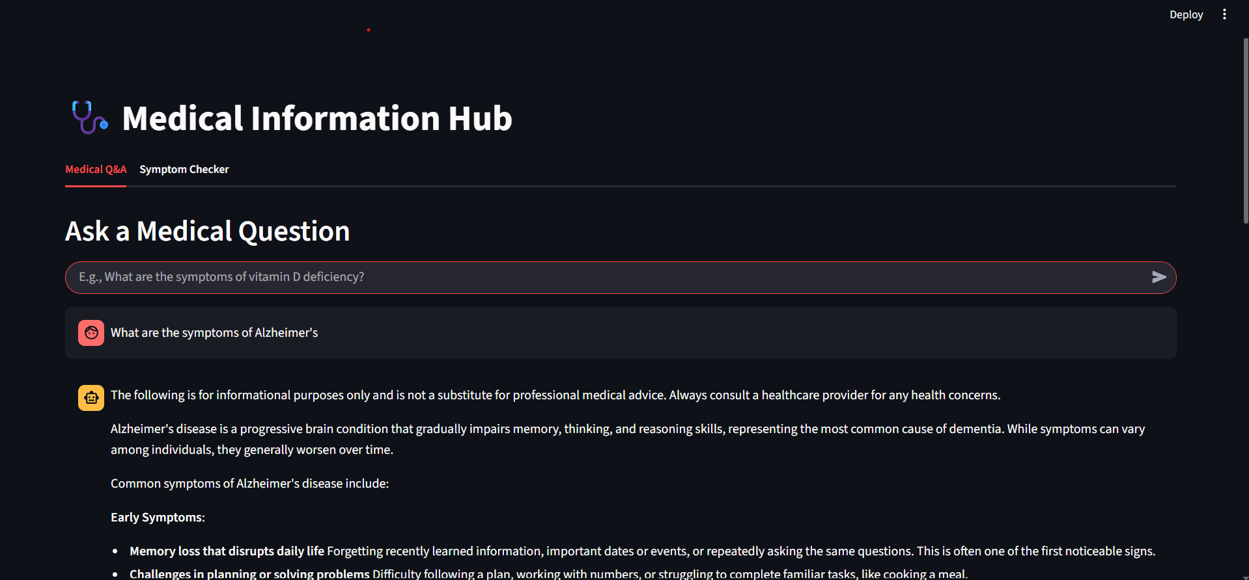
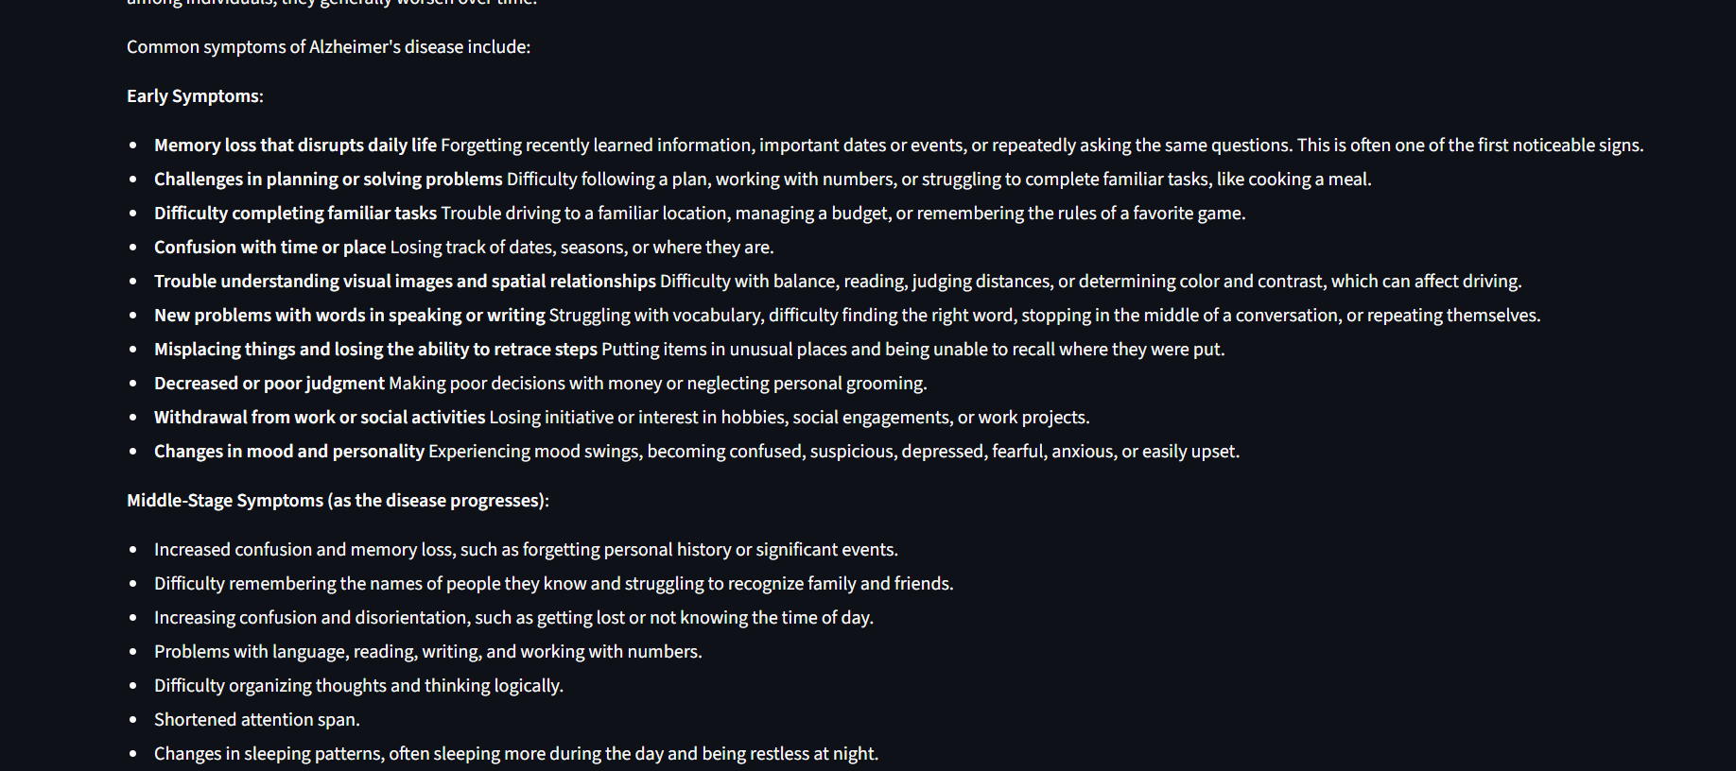

Feature 2 - Generative Q&A with Grounding
Answering General Questions with Verifiable Sources
How it Works:
The user asks any medical question in a chat interface.
The app calls the Gemini API with the Google Search tool enabled.
The model uses search results to formulate a detailed and accurate answer.
Key Benefit: The app displays the source links used by the AI, providing transparency and allowing the user to verify the information.

Slide 9
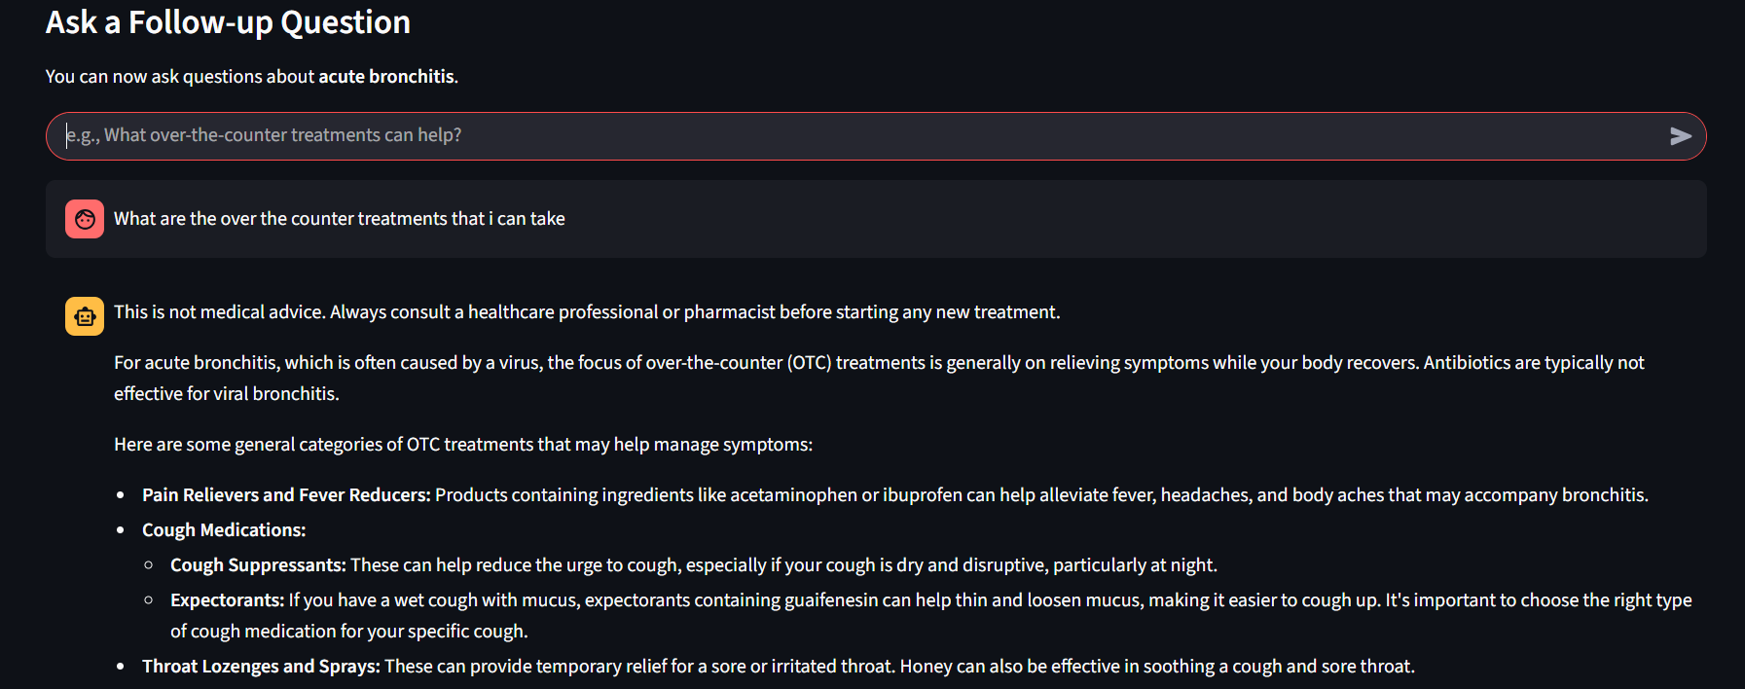
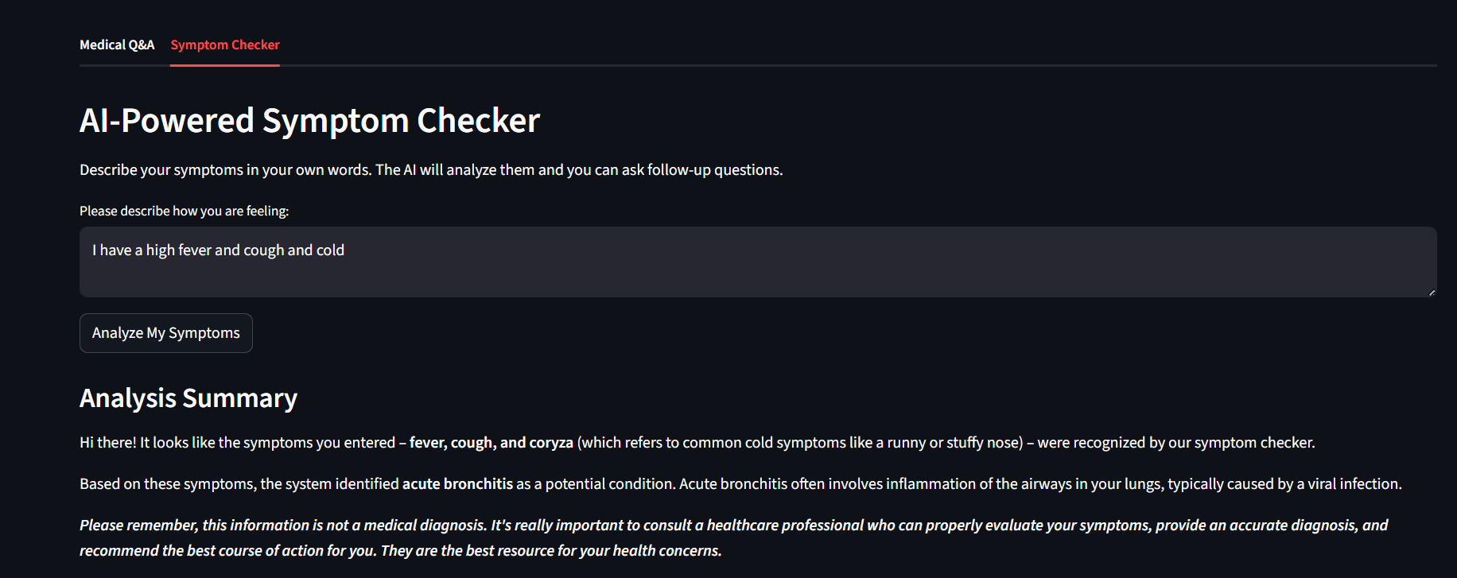
Live Demo / Walkthrough
Scenario 1 (Symptom Checker):
Scenario 2 (Q&A Tab):
Show a user asking, "What are the early signs of diabetes?"
Show the user typing "I have a sore throat and I'm sneezing."
Display the AI's detailed answer, followed by the list of sources.
Display the AI's analysis summary (e.g., "Based on your symptoms... this could be related to the Common Cold...").
Show a follow-up question like "What OTC medicine helps?" and the safe, general response.

Slide 10
Challenges & Solutions
Challenge 1: Preventing the AI from giving dangerous or specific medical advice.
Challenge 2: Ensuring the AI's symptom extraction is accurate and constrained.
Challenge 3: Keeping general information current.
Solution: Utilised Google Search grounding in the Q&A tab to pull from up-to-date web sources.
Solution: Implemented strict, multi-layered prompt engineering with explicit negative constraints (no dosages, no brand names). The application, not the AI, has the final say on disclaimers.
Solution: Provided the AI with a complete list of valid symptoms and forced a JSON output, minimising hallucinations and errors.

Slide 11




Future Enhancements
Data Expansion
Ingest a larger, more comprehensive dataset of diseases and symptoms.
User Profiles
Allow users to save their history for ongoing tracking.
Multilingual Support
Localise the interface and prompts for broader accessibility.
API Refinement
Explore newer, more advanced models as they become available for improved nuance and accuracy.

Slide 12
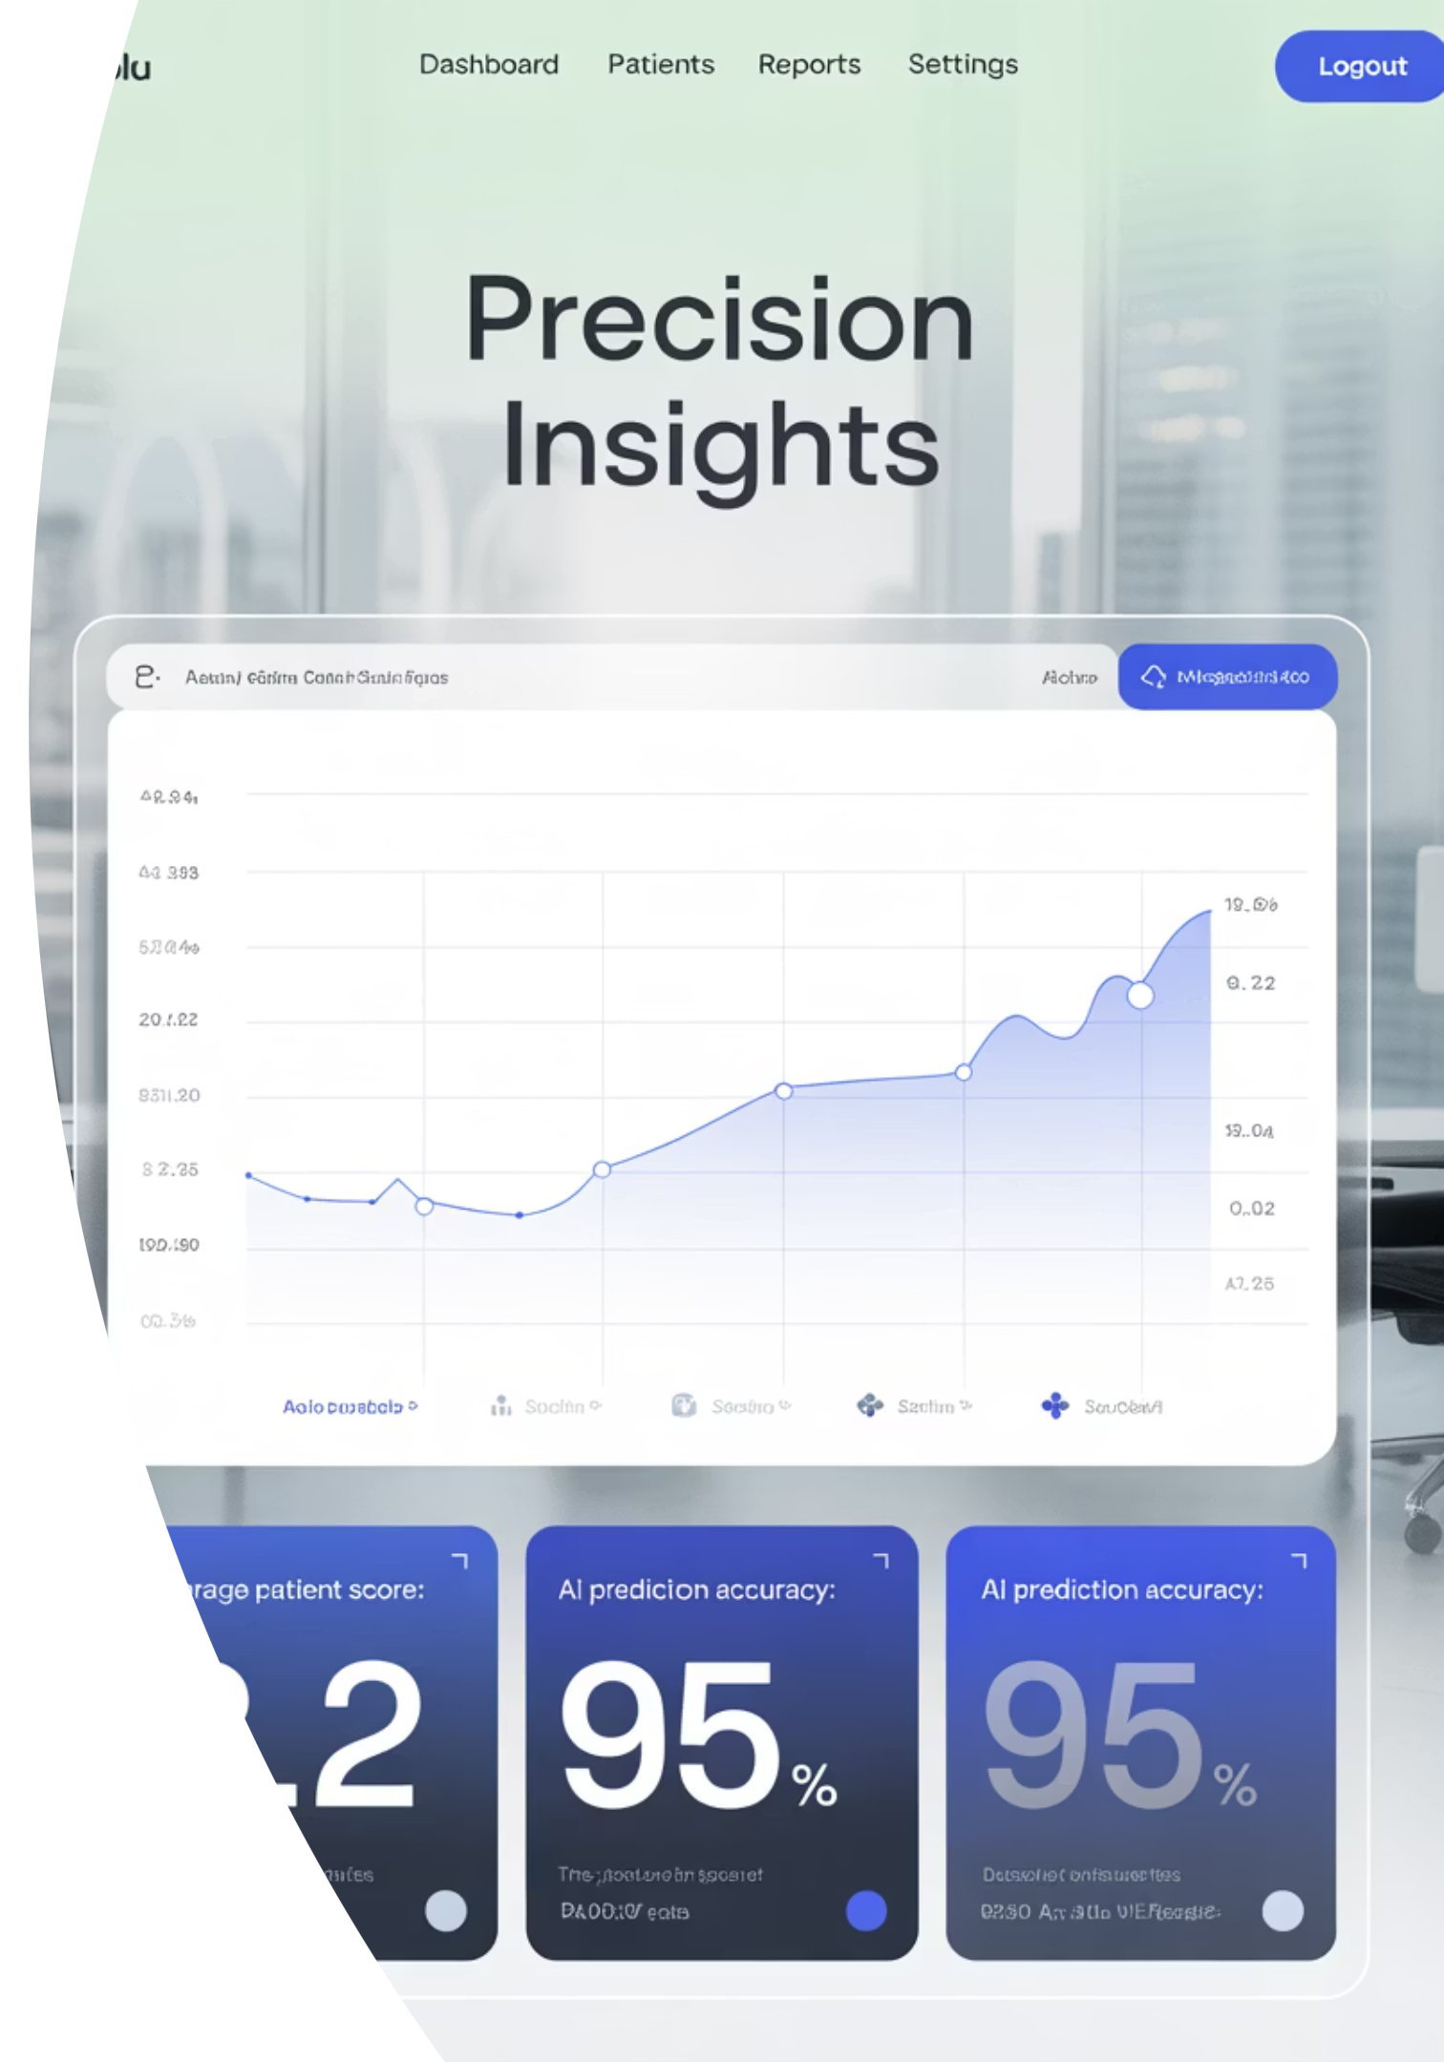
Conclusion
Project successfully demonstrates how Generative AI can be responsibly used to create a helpful medical information tool.
By prioritising safety through prompt engineering and maintaining a clear boundary between information and diagnosis, the application serves as a valuable resource for users.
It empowers users with accessible information while consistently guiding them toward professional medical care.

